Slide 1
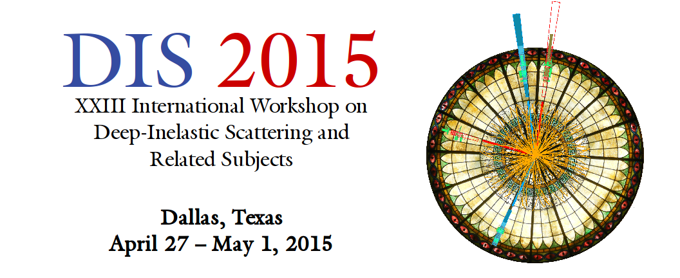



Spin Physics and Transverse Structure
Piet Mulders
mulders@few.vu.nl

Slide 2
ABSTRACT
Spin Physics and Transverse Structure
Piet Mulders (Nikhef Theory Group/VU University Amsterdam)
Spin is a welcome complication in the study of partonic structure that has led to new insights, even if experimentally not all dust has settled, in particular on quark flavor dependence and gluon spin. At the same time it opened new questions on angular momentum and effects of transverse structure, in particular the role of the transverse momenta of partons. This provides again many theoretical and experimental challenges and hurdles. But it may also provide new tools in high-energy scattering experiments linking polarization and final state angular dependence.

Slide 3
Parton distribution (PDF) and fragmentation (PFF) functions
Parton densities (PDFs) and decay functions (PFFs) are natural way of dealing with quarks/gluons in high energy processes (several PDF databases)
PDFs can be embedded in a field theoretical framework via Operator Product Expansion (OPE), connecting Mellin moments of PDFs with particular QCD matrix elements of operators (spin and twist expansion)
Hard process introduces necessary directionality with light-like directions, P – M² n and n = P’/P.P’ (satisfying P.n = 1)
The lightcone momentum fraction x of the parton momentum p = x P is linked to x_{B} = Q²/2P.q (DIS) or x₁ = q.P₂/P₁.P₂ and x₂ = q.P₁/P₁.P₂ (DY)
Polarization, MS = S_{L} P + MS_{T} − M² S_{L} n (longitudinal or transverse) is a welcome complication, experimentally challenging but new insights emerged
Consideration of partonic transverse momenta, p = x P + p_{T} + (p² p_{T}²) n opens new avenues to Transverse Momentum Dependent (TMD) PDFs, in short TMDs with experimental and theoretical challenges
The measurement is mostly not for free, but requires dedicated final states (jets/flavor), polarized targets or polarimetry e.g. through decay orientation of final states (ρ or Λ)

Slide 4
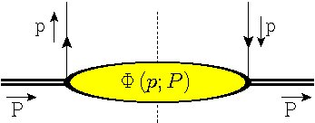
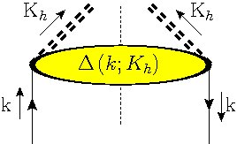
Link to matrix elements → hadron correlators
Structure of PDFs and PFFs as correlators built from nonlocal field configurations, extending on OPE and useful for interpretation, positivity bounds, modelling, …
parametrized using symmetries (C, P, T)
|X><X| gateway to models: e.g. diquarks
WG6/12 Mao, Lu, Ma
AUT predictions (diquark model)
no T-invariance!
Collins & Soper, NP B 194 (1982) 445
Notes:
Remark on notation of (p|p)

Slide 5

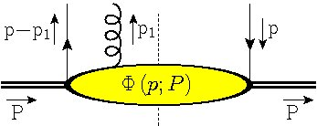
Link to matrix elements → hadron correlators
Gluonic matrix elements
Also needed are multi-parton correlators
or better:
(color gauge invariance)
Φ_{A}(p-p₁,p)
Notes:
Remark on notation of (p|p)

Slide 6
(Un)integrated correlators
p⁻ = p.P integration makes time-ordering automatic. The soft part is simply sliced at a light-front instance
Is already equivalent to a point-like interaction
Local operators with calculable anomalous dimension
unintegrated
TMD (light-front)
collinear (light-cone)
local
Notes:
Parton momentum has four components
Not-time-ordered
Integrate p-

Slide 7
TMDs and color gauge invariance
Gauge invariance in a non-local situation requires a gauge link U(0,ξ)
Introduces path dependence for Φ(x,p_{T})
ξ_{Τ}
ξ
ξ.P
0
Notes:
Matrix elements are not gauge invariant
OPE

Slide 8
Parametrization of Φ(x) → collinear PDFs
p = x P
compare
Quarks in nucleon:
unpolarized quarks

Slide 9
Parametrization of Φ(x) → collinear PDFs
compare
Quarks in nucleon:
Operator connection through Mellin moments
Anomalous dimensions can be Mellin transformed into the splitting functions that govern the QCD evolution.
unpolarized quarks
x = p⁺ = p.n

Slide 10
Collinear PDFs without polarization
p = x P
compare
Quarks in nucleon:
unpolarized quarks

Slide 11
Collinear PDFs with polarization
Quarks in polarized nucleon:
T-polarized quarks in T-polarized N
unpolarized quarks
chiral quarks in L-polarized N
compare
compare
spin ←→ spin
DIS/SIDIS programme to obtain
Flavor PDFs: q(x) = f₁^{q}(x)
Polarized PDFs: Δq(x) = g_{1L}^{q}(x)
δq(x) = h_{1T}^{q}(x)
WG6/70
JAM global QCD analysis
WG6/142 Drachenberg (STAR)
Transversity in polarized pp
WG6/150 Gunarathne (STAR)
Longitudinal spin asymm. in W prod.

Slide 12
TMDs with polarization
Quarks in polarized nucleon:
… but also
T-polarized quarks in T-polarized N
chiral quarks in L-polarized N
unpolarized quarks
compare
spin ←→ spin
chiral quarks in T-polarized N
(worm-gear)

Slide 13
TMDs with polarization
Quarks in polarized nucleon:
… but also
T-polarized quarks in T-polarized N
chiral quarks in L-polarized N
unpolarized quarks
compare
spin ←→ spin
T-polarized quarks in T-polarized N
(pretzelocity)
WG6/103 Prokudin, Lefky
Extraction pretzelosity distribution

Slide 14
TMDs with polarization
… and T-odd functions
spin-orbit correlations are T-odd correlations. Because of T-conservation they show up in T-odd observables, such as single spin asymmetries, e.g. left-right asymmetry in
T-polarized quarks in unpolarized N
(Boer-Mulders)
unpolarized quarks in T-polarized N (Sivers)
compare
spin ←→ orbit

Slide 15
TMD structures for quark PDFs
QUARKS
U
L
T

Slide 16
gluon TMD’s without polarization
Also for gluons there are new features in TMD’s
Collinear situation:
Unpolarized gluon PDFs: g(x) = f₁^{g}(x)
Polarized gluon PDF: Δg(x) = g_{1L}^{g}(x)
Some of the TMDs also show up in resummation. An example are the linearly polarized gluons (Catani, Grazzini, 2011)
circularly polarized gluons in L-pol. N
unpolarized gluons in unpol. N quarks
compare
linearly polarized gluons in unpol. N
(Rodrigues, M)
WG6/75 Li (STAR)
Jet and di-jet in pol. pp
WG6/63 Guragain (PHENIX)
A_{LL} results, impact on Δg
WG6/316 Pisano
Linear polarization Higgs + jet prod

Slide 17
TMD structures for quark and gluon PDFs
QUARKS
U
L
T
GLUONS
U
L
T

Slide 18
TMD structures for quark and gluon PFFs
QUARKS
U
L
T
GLUONS
U
L
T

Slide 19
Requirements and possibilities to measure Q_{T}
  Parton collinear momentum (lightcone fractions) ←→ scaling variables
Parton transverse momenta appear in noncollinear phenomena (azimuthal asymmetries)
  Jet fragments: k = K_{h}/z + k_{T} or k_{T} = k – K_{h}/z = k_{jet} – K_{h}/z
  SIDIS: q + p = k but q + x P_{H} ≠ K_{h}/z
  Hadrons: p₁ + p₂ = k₁ + k₂ but x₁ P₁ + x₂ P₂ ≠ k₁ + k₂
Two ‘separated’ hadrons involved in a hard interaction (with scale Q), e.g. SIDIS-like (γ*H → h X or γ*H → jet X), DY-like (H₁H₂ → γ* X or H₁H₂ → dijet X or H₁H₂ → Higgs X), annihilation (e⁺e⁻ → h₁h₂ X or e⁺e⁻ → dijet X)
Number of p_{T}’s in parametrization ←→ rank of TMDs ←→ azimuthal sine or cosine mφ asymmetry → Need for dedicated facilities at low and high energies

Slide 20
Rich phenomenology
WG6/151 Seder (COMPASS)
Charged kaon multiplicities in SIDIS
WG6/75 Li (STAR)
Jet and di-jet in pol. pp
WG6/161 Vossen
FFs at Belle
WG6/136 Diefenthaler (SeaQuest)
Polarized DY measurements
WG6/135 Sbrizzai (COMPASS)
Transverse spin asymmetries SIDIS
WG6/153 Barish (PHENIX)
Transverse Single-spin asymm.
WG6/84 Anulli
Collins Asymmetry with BaBar
WG6/139 Allada
Recent SIDIS results at JLab
WG6/22 Lyu
Collins Asymmetry at BESIII
WG6/318 Liyanage
Recent polarized DIS results at JLab

Slide 21
TMDs and factorization
Collinear PDFs involve operators of a given twist
x ‘measurable’
TMDs involve operators of all twist
p_{T} in a convolution (scale and rapidity cutoffs)
Impact parameter representation including also large b_{T}
At small b_{T}, large k_{T} collinear physics (Collins-Soper-Sterman)
WG6/33 Collins
TMD factorization and evolution
J.C. Collins, Foundations of Perturbative QCD, Cambridge Univ. Press 2011
WG6/312 Kang
TMD evolution and global analysis

Slide 22
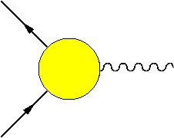
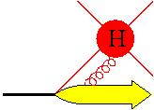
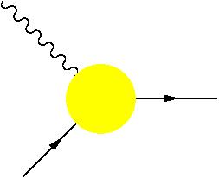
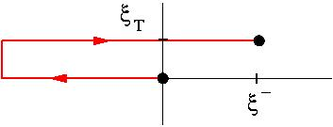
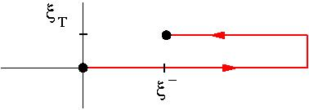
Non-universality because of process dependent gauge links
TMD
path dependent gauge link
Gauge links associated with dimension zero (not suppressed!) collinear A^{n} = A⁺ gluons, leading for TMD correlators to process-dependence:
DY
SIDIS
… A⁺ …
(resummation)
… A⁺ …
Φ^{[-]}
Φ^{[+]}
Time reversal
Belitsky, Ji, Yuan, 2003; Boer, M, Pijlman, 2003
Notes:
No unique way
Examples: DY & SIDIS
After integration: the same

Slide 23
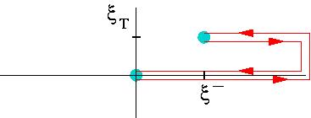
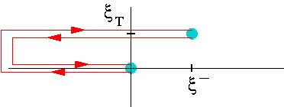
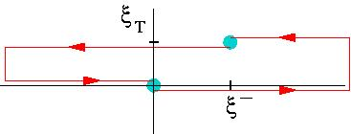
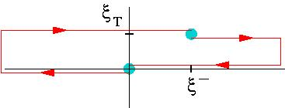
Non-universality because of process dependent gauge links
The TMD gluon correlators contain two links, which can have different paths. Note that standard field displacement involves C = C’
Basic (simplest) gauge links for gluon TMD correlators:
gg ➔ H
Φ_{g}^{[+,+]}
Φ_{g}^{[-,-]}
Φ_{g}^{[+,-]}
Φ_{g}^{[-,+]}
in gg ➔ QQ
Bomhof, M, Pijlman, 2006; Dominguez, Xiao, Yuan, 2011

Slide 24
Consequences for parametrizations of TMDs
Gauge link dependence
Leading quark TMDs
Leading gluon TMDs

Slide 25
Transverse moments → operator structure of TMD PDFs
Operator analysis for TMD functions: in analogy to Mellin moments consider transverse moments involving gluonic operators
calculable
T-even
T-odd
T-even (gauge-invariant derivative)
T-odd (soft-gluon or gluonic pole, ETQS m.e.)
Efremov, Teryaev; Qiu, Sterman;
Brodsky, Hwang, Schmidt; Boer, Teryaev; Bomhof, Pijlman, M
Notes:
Gauge link has richer structure
3 matrix elements

Slide 26
TMD and collinear twist 3
There are many more links between TMD factorized results, pQCD resummation results and collinear twist 3 results:
WG6/57 Pitonyak et al.
Transverse SSA in pp → π/γ X
WG6/120 Koike
Collinear twist 3 for spin asymm.
WG6/309 Metz
Twist-3 spin observables
WG6/108 Dai Lingyun
Sivers asymmetry in SIDIS
WG6/104 Granados
Left-right asymm. in chiral dynamics
WG6/315 Burkardt
Transverse Force on Quarks in DIS

Slide 27
Operator classification of TMDs according to rank
factor | TMD PDF RANK
 | 0 | 1 | 2 | 3
1
Buffing, Mukherjee, M

Slide 28
Distribution versus fragmentation functions
Operators:
Operators:
out state
T-even
T-odd (gluonic pole)
T-even operator combination, but still T-odd functions!
Collins, Metz; Meissner, Metz; Gamberg, Mukherjee, M

Slide 29
Operator classification of TMDs
factor | TMD PDF RANK
 | 0 | 1 | 2 | 3
1
factor | TMD PFF RANK
 | 0 | 1 | 2 | 3
1
Buffing, Mukherjee, M

Slide 30
Operator classification of quark TMDs (unpolarized nucleon)
Example: quarks in an unpolarized target are described by just 2 TMD structures; in general rank is limited to to 2(S_{hadron}+s_{parton})
Gauge link dependence:
(coupled to process!)
factor | QUARK TMD PDF RANK UNPOLARIZED HADRON
 | 0 | 1 | 2 | 3
1
T-even
T-odd
[B-M function]

Slide 31
Operator classification of quark TMDs (polarized nucleon)
factor | QUARK TMD PDFs RANK SPIN ½ HADRON
 | 0 | 1 | 2 | 3
1
Three pretzelocities:
Process dependence also for (T-even) pretzelocity,
Buffing, Mukherjee, M

Slide 32
Operator classification of TMDs (including trace terms)
factor | GLUON TMD PDF RANK UNPOLARIZED HADRON
 | 0 | 1 | 2 | 3
1
Note also process dependence of (T-even) linearly polarized gluons
Buffing, Mukherjee, M

Slide 33
Operator classification of TMDs (including trace terms)
factor | TMD PDF RANK
 | 0 | 1 | 2 | 3
1
Trace terms affect p_{T} width (note Φ_{G.G}(x) = 0)
Boer, Buffing, M, arXiv:1503.03760

Slide 34
Operator classification of TMDs (including trace terms)
factor | GLUON TMD PDF RANK UNPOLARIZED HADRON
 | 0 | 1 | 2 | 3
1
Note process dependence, not only of linearly polarized gluons but also affecting the p_{T} width of unpolarized gluons
with δf₁^{g(Bc)}(x) = 0
Boer, Buffing, M
Boer, Buffing, M, arXiv:1503.03760

Slide 35
Operator classification of TMDs (including trace terms)
factor | QUARK TMD PDFs RANK SPIN ½ HADRON
 | 0 | 1 | 2 | 3
1
Process dependence in p_{T} width of TMDs is due to gluonic pole operator (e.g. Wilson loops)
with δf₁^{(Bc)}(x) = 0
Boer, Buffing, M, arXiv:1503.03760

Slide 36
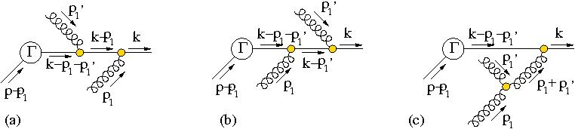
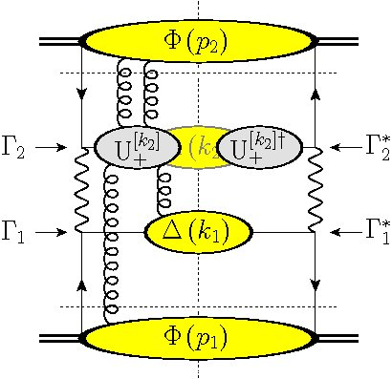
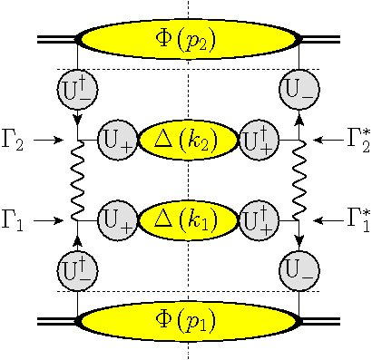
Entanglement in processes with two initial state hadrons
Resummation of collinear gluons coupling onto external lines contribute to gauge links
…. leading to entangled situation (Rogers, M), breaking universality
Gauge knots (Buffing, M)
Notes:
More complicated gauge links
Color-entanglement
Explicit calc: some contributions break factorizatn
On the right, a more detailed picture is visible. No factorization

Slide 37
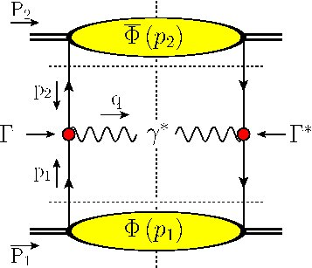
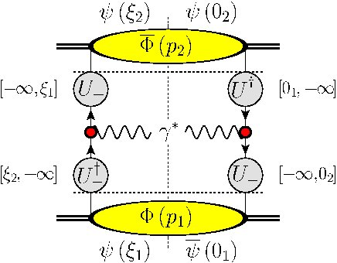
Correlators in description of hard process (e.g. DY)
Two initial state hadrons (e.g. DY)
Complications if the transverse momentum of two initial state hadrons is involved, resulting for DY at measured Q_{T} in
This leads to color factors just as for twist-3 squared in collinear DY
Buffing, M, PRL 112 (2014), 092002

Slide 38
Attempts to provide a useful database have started

Slide 39
Conclusions and outlook
TMDs extend collinear PDFs (including polarization 3 for quarks and 2 for gluons) to novel TMD PDF and PFF functions
Although operator structure includes ultimately the same operators as collinear approach, it is a physically relevant combination/resummation of higher twist operators that governs transverse structure (definite rank linked to azimuthal structure)
Knowledge of operators for transverse structure is important for interpretation, relations to twist 3 and lattice calculations.
Transverse structure for PDFs (in contrast to PFFs) requires careful study of process dependence linked to color flow in hard process
Like spin, the transverse structure does offer valuable tools, but you need to know how to use them!

Slide 40
Some other (related) contributions
WG6/21 Lowdon (ArXiv:1408.3233)
Spin operator decompositions
WG6/58 Courtoy, Bacchetta, Radici
Collinear Dihadron FFs
WG6/102 Prokudin et al.
Tensor charge from Collins asymm.
WG2/87 Yuan
TMDs at small x
WG6/304 Kasemets
Polarization in DPS
WG6/315 Burkardt
Transverse Force on Quarks in DIS
WG2/112 Tarasov
Rapidity evolution of gluon TMD
WG2/87 Yuan
TMDs at small-x
WG2/326 Stasto
Matching collinear and small-x fact.
WG4/88 Yuan
Soft gluon resumm for dijets
WG7/297 Zhihong
SoLID-SIDIS: future of T-spin, TMD
WG1/325 Kasemets
TMD (un)polarized gluons in H prod

