Slide 1




Transverse Momentum Dependent Distribution and Fragmentation Functions in High Energy Scattering Processes
17th Taiwan Nuclear Physics Summer School
August 25~28, 2014, Institute of Physics, Academia Sinica, Taipei
August 25 - 28, 2014,
Institute of Physics, Academia Sinica, Taipei
Piet Mulders
mulders@few.vu.nl

Slide 2
ABSTRACT
Transverse Momentum Dependent Parton Distribution and Fragmentation Functions of Hadrons
Piet Mulders (Nikhef Theory Group/VU University Amsterdam)
Hadrons are bound state of colored constituents. The information on these constituents, quarks and gluons (partons) and their use as probes in scattering processes thus is indirect. At high energies, the relevant connections can be made with distribution functions (PDFs) and fragmentation functions (PFFs) for the partons. In the simplest cases one only needs to deal with the momentum fractions of the partons with respect to parent hadron or with momentum fraction of produced hadron with respect to produced parton. Transverse Momentum Dependent (TMD) parton distribution (PDF) and parton fragmentation (PFF) functions also take into account the intrinsic transverse momentum (p_{T}) of the partons. The p_{T}-integrated analogues can be linked directly to quark and gluon matrix elements using Operator Product Expansion in QCD, involving operators of definite twist. TMDs also involve operators of higher twist, which are not suppressed by powers of the hard scale, however. In this talk I will address the relevance of both quark and gluon TMDs in azimuthal and spin asymmetries and address theoretical issues related to gauge links, universality of the functions and the essential difference between T-odd PDFs and PFFs.

Slide 3











Collaborators (a.o.)
Daniel Boer
(Groningen)
Leonard Gamberg
(Penn State)
Asmita Mukherjee
(Mumbai)
Maarten Buffing
AndreaSignori
Sabrina Cotogno
Tom van Daal
Tomas Kasemets
Miguel Echevarria
Cristian Pisano
Jian Zhou

Slide 4
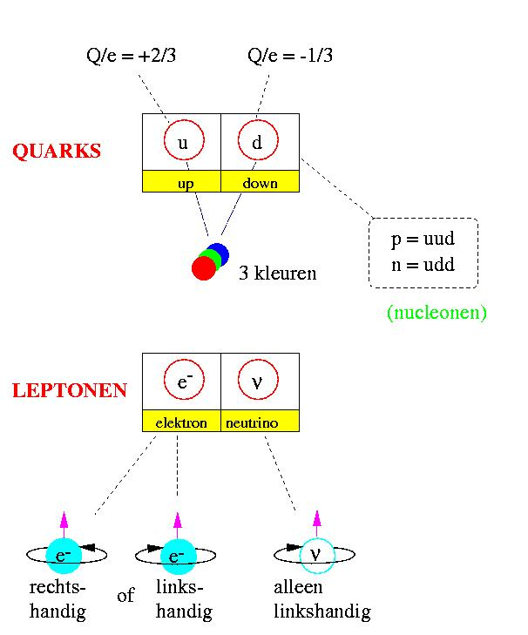
Valence structure of hadrons: global properties
mass
charge
spin
magnetic moment
isospin, strangeness
baryon number
M_{p} ≈ M_{n} ≈ 940 MeV
Q_{p} = 1, Q_{n} = 0
s = ½
g_{p} ≈ 5.59, g_{n} ≈ -3.83
I = ½: (p,n) S = 0
B = 1
Quarks as constituents
d
u
u
proton
3 colors

Slide 5
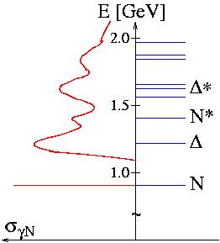
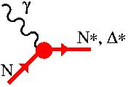
A real look at the proton
γ + N → ….
Nucleon excitation spectrum
E ~ 1/R ~ 200 MeV
R ~ 1 fm

Slide 6
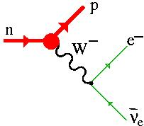
A (weak) look at the nucleon
n → p + e⁻ + ν
= 900 s
→ Axial charge
G_{A}(0) = 1.26

Slide 7
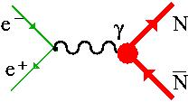
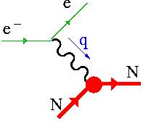
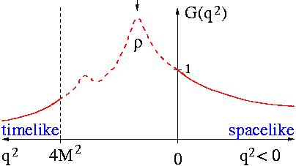
A virtual look at the proton
_
γ∗ → N N
γ∗ + N → N

Slide 8
Local – forward and off-forward m.e.
Local operators (coordinate space densities):
Δ
P
P’
Form factors
Static properties:
Examples:
(axial) charge
mass
spin
magnetic moment
angular momentum

Slide 9
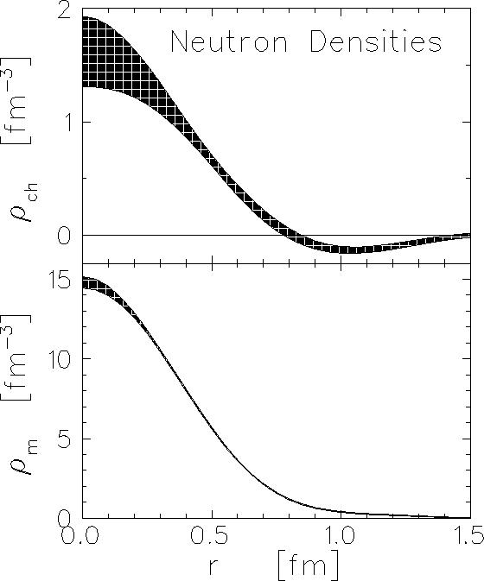
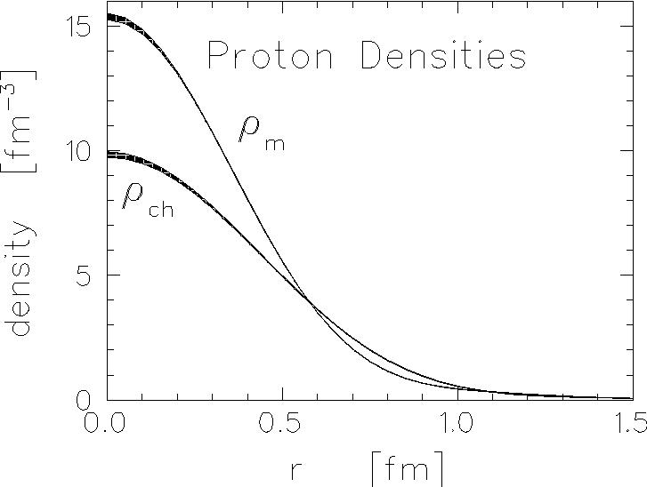
Nucleon densities from virtual look
neutron
proton
charge density ≠ 0
u more central than d?
role of antiquarks?
n = n₀ + pπ⁻ + … ?

Slide 10
Quark and gluon operators
Given the QCD framework, the operators are known quarkic or gluonic currents such as
probed in specific combinations
by photons, Z- or W-bosons
(axial) vector currents
energy-momentum currents
probed by gravitons

Slide 11
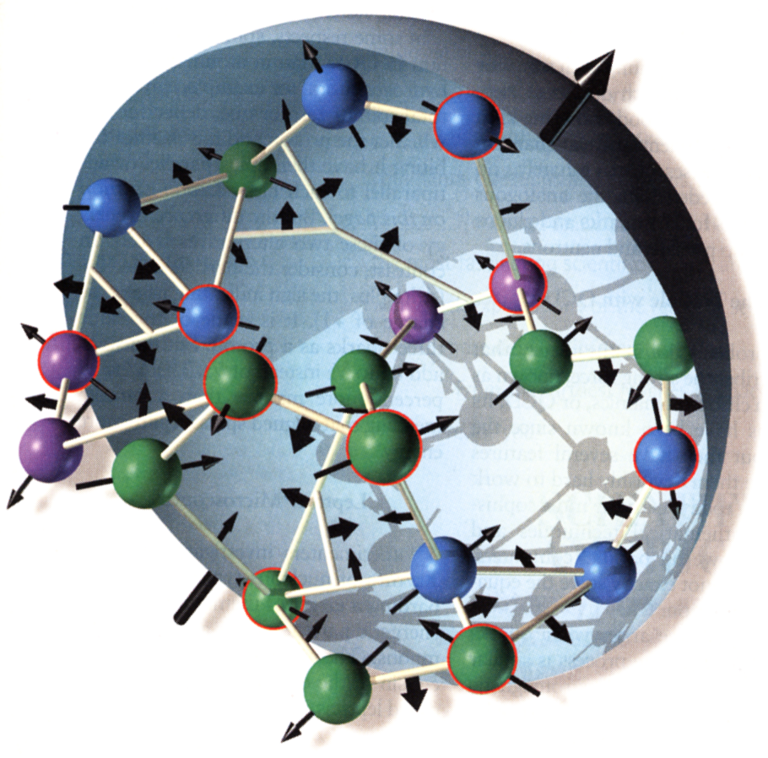
Towards the quarks themselves
The current provides the densities but only in specific combinations, e.g. quarks minus antiquarks and only flavor weighted
No information about their correlations, (effectively) pions, or …
Can we go beyond these global observables (which correspond to local operators)?
Yes, in high energy (semi-)inclusive measurements we will have access to non-local operators!
L_{QCD} (quarks, gluons) known!

Slide 12
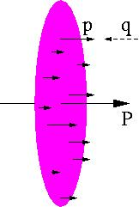
Non-local probing
Nonlocal forward operators (correlators):
Specifically useful: ‘squares’
Selectivity at high energies: q = p
Momentum space densities of Ψ-ons:

Slide 13
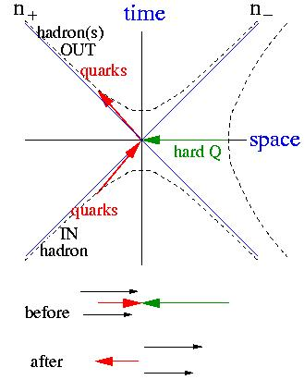
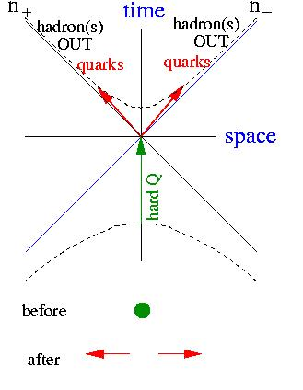
A hard look at the proton
Hard virtual momenta (± q² = Q² ~ many GeV²) can couple to (two) soft momenta
γ∗ + N → jet
γ∗ → jet + jet

Slide 14
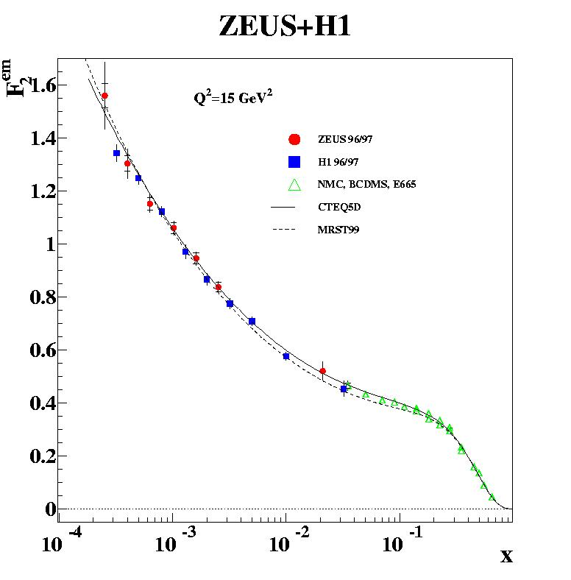
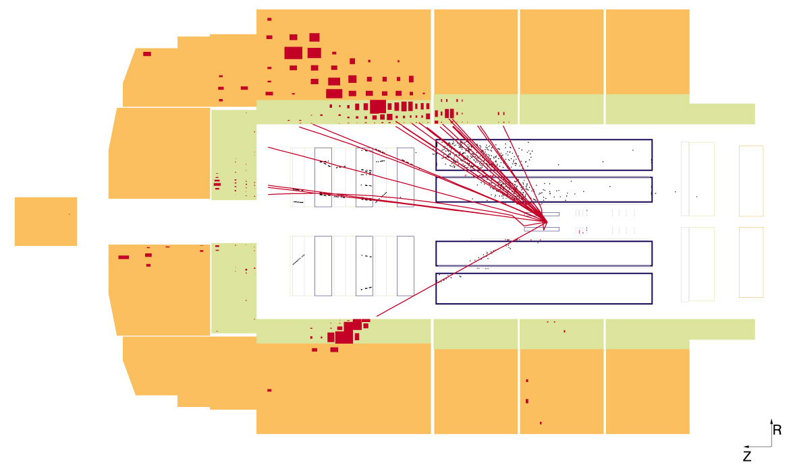
Experiments!

Slide 15
QCD & Standard Model
QCD framework (including electroweak theory) provides the machinery to calculate cross sections, e.g. γ*q → q, qq → γ*, γ* → qq, qq → qq, qg → qg, etc.
E.g.
qg → qg
Calculations work for plane waves
_
_

Slide 16
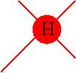
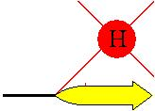
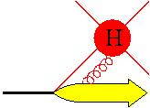
Soft part: hadronic matrix elements
For hard scattering process involving electrons and photons the link to external particles is, indeed, the ‘one-particle wave function’
Confinement, however, implies hadrons as ‘sources’ for quarks
… and also as ‘source’ for quarks + gluons
… and also ….
PARTON CORRELATORS

Slide 17
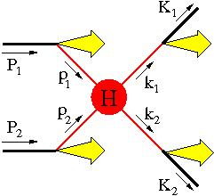
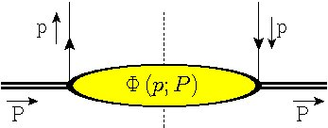
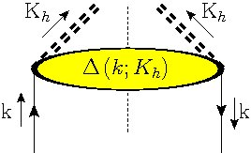
PDFs and PFFs
Basic idea of PDFs and PFFs (also for TMDs) is to obtain a full factorized description of high energy scattering processes
calculable
defined (!)
&
portable
Give a meaning to integration variables!

Slide 18
Hadron correlators
At high energies no interference and squared amplitudes can be rewritten as correlators of forward matrix elements of parton fields
Math:
Picture:
Use symmetries (P, T) and hermicity to parametrize these objects!
Notes:
Remark on notation of (p|p)

Slide 19
Hadron correlators
At high energies no interference and squared amplitudes can be rewritten as correlators of matrix elements of parton fields
Math:
Picture:
no T-constraint
T|K_{h},X>_{out} = |K_{h},X>_{in}
Collins & Soper, NP B 194 (1982) 445
Notes:
Remark on notation of (p|p)

Slide 20
Role of the hard scale
In high-energy processes hard momenta are available, such that P.P’ ~ s with a hard scale s >> M²
Employ light-like vectors P and n, such that P.n = 1 (e.g. n = P’/P.P’) to make a Sudakov expansion of parton momentum (write s = Q²)
Enables expansion in inverse hard scale (twist analysis) for integrated correlators,
~ Q
~ M
~ M²/Q
Notes:
Without twist-dimensional analysis
Sudakov expansion allows importance sampling
Integrating out momenta components one at a time

Slide 21
(Un)integrated correlators
σ = p⁻ integration makes time-ordering automatic. The soft part is simply sliced at the light-front
Is already equivalent to a point-like interaction
Local operators with calculable anomalous dimension
unintegrated
TMD (light-front)
collinear (light-cone)
local
Notes:
Parton momentum has four components
Not-time-ordered
Integrate p-

Slide 22
Example using correlators (DIS)

Slide 23
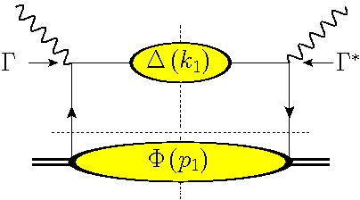
Principle for DIS
q
p
P
Instead of partons use correlators
Expand parton momenta (for SIDIS take e.g. n= P_{h}/P_{h}.P)
~ Q
~ M
~ M²/Q

Slide 24
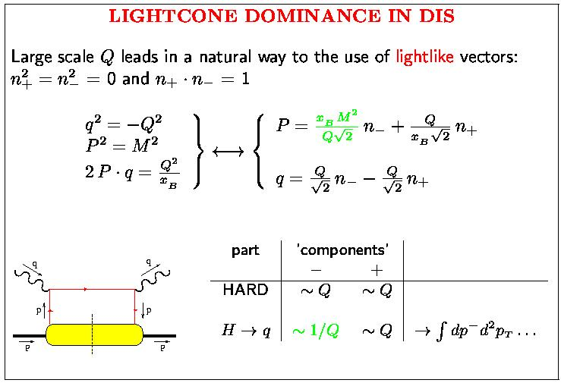

Slide 25
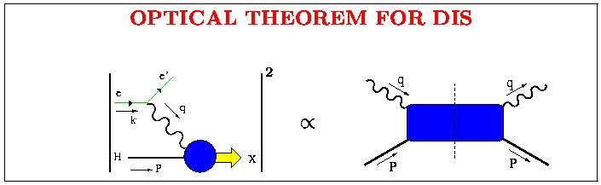
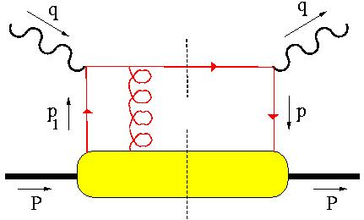
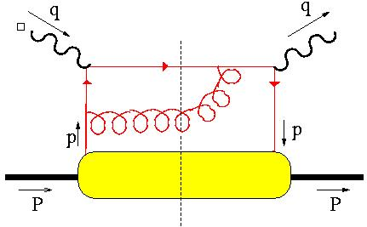
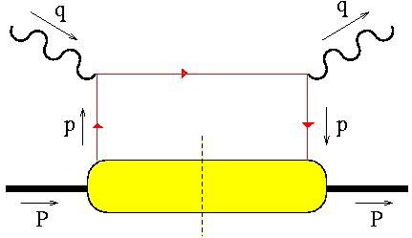
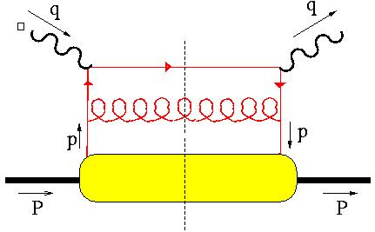
(calculation of) cross section in DIS
Full calculation
+
+
Φ(x)
+
+ …
LEADING (in 1/Q)
x = x_{B} = −q²/P.q

Slide 26
Result for DIS
q
p
P

Slide 27
Twist analysis (1)
Dimensional analysis to determine importance in an expansion in inverse hard scale
Maximize contractions with n
… or maximize # of P’s in parametrization of Φ
Note that these are densities!

Slide 28
Parametrization of TMDs

Slide 29
Ingredients in parametrization
Building blocks: momenta and spins
Handling of spin in distributions (spin of hadrons can be tuned)
Handling of spin in fragmentations (spin of produced hadrons cannot be tuned!)
Color summation in distribution functions
Color averaging in fragmentation functions

Slide 30
Symmetry constraints
Hermiticity
Parity
Time reversal
Charge conjugation (giving antiquark corr)
Parametrization of TMD correlator for unpolarized hadron:
(unpolarized and transversely polarized quarks)
T-even
T-odd
Mulders, Tangerman, Boer; Bacchetta, Diehl, Goeke, Metz, M, Schlegel, JHEP02 (2007) 093

Slide 31
New information in TMD’s: f(x,p_{T}) or D(1/z,k_{T})
Quarks in polarized nucleon:
… but also
chiral quarks in L-polarized N
unpolarized quarks
compare
T-polarized quarks in T-polarized N
spin ←→ spin
chiral quarks in T-polarized N

Slide 32
New information in TMD’s: f(x,p_{T}) or D(1/z,k_{T})
… and T-odd functions
Yes, definitely there is new information and even very interesting spin-orbit correlations (single spin!). These are T-odd and because of T-conservation show up in T-odd observables, such as single spin asymmetries, e.g. left-right asymmetry in
T-polarized quarks in unpolarized N
(Boer-Mulders)
unpolarized quarks in T-polarized N (Sivers)
compare
spin ←→ orbit

Slide 33

New information in gluon TMD’s: f(x,p_{T}) or D(1/z,k_{T})
Also for gluons there are new features in TMD’s
circularly polarized gluons in L-pol. N
spin ←→ spin
unpolarized gluons in unpol. N quarks
linearly polarized gluons in unpol. N
(Gluon Boer-Mulders)
compare
spin ←→ orbit

Slide 34
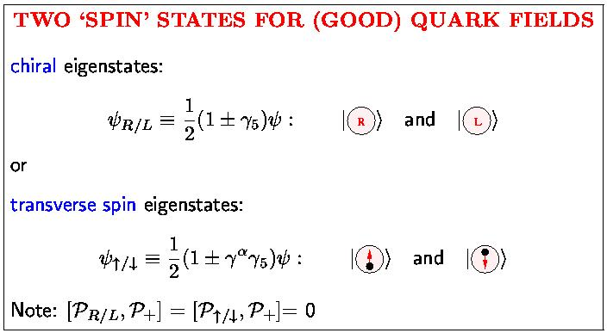
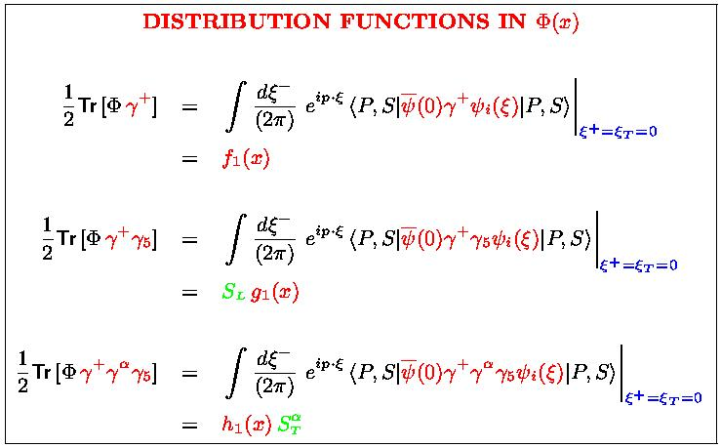
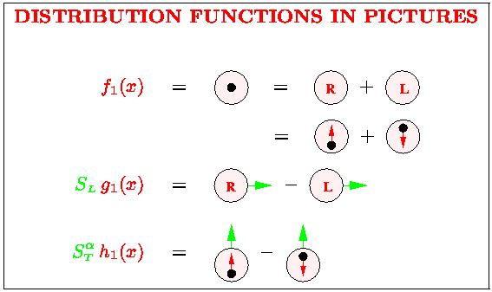
Basis of partons
‘Good part’ of Dirac
space is 2-dimensional
Interpretation of DF’s
unpolarized quark
distribution
helicity or chirality
distribution
transverse spin distr.
or transversity

Slide 35
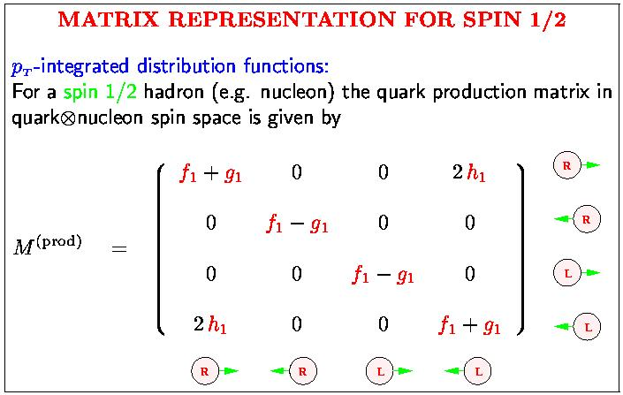
Matrix representation for M = [Φ(x)γ⁺]^{T}
Bacchetta, Boglione, Henneman & Mulders
PRL 85 (2000) 712
Quark production matrix, directly related to the
helicity formalism
Anselmino et al.
Off-diagonal elements (RL or LR) are chiral-odd functions
Chiral-odd soft parts must appear with partner in e.g. SIDIS, DY

Slide 36
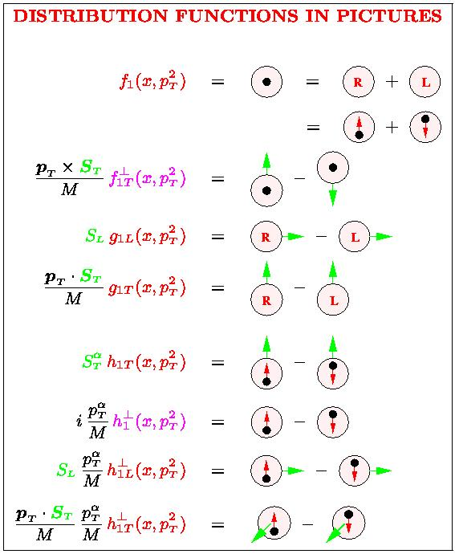
Fermionic structure of TMDs
unpolarized quark
distribution
with p_{T}
T-odd
helicity or chirality
distribution
with p_{T}
f₁^{q}(x) = q(x)
g₁^{q}(x) = Δq(x)
h₁^{q}(x) = δq(x)
T-odd
with p_{T}
transverse spin distr.
or transversity
with p_{T}
with p_{T}

Slide 37
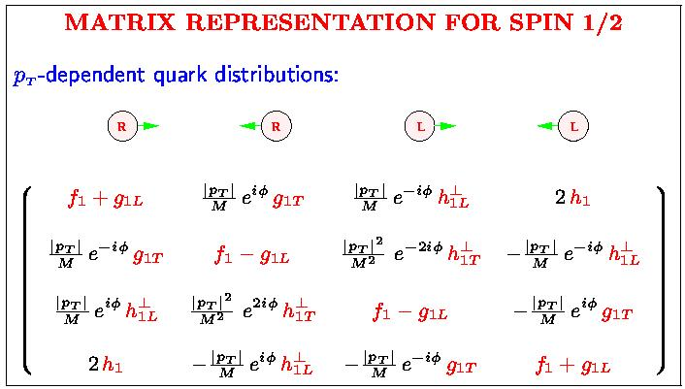
Matrix representation for M = [Φ[±](x,p_{T})γ⁺]^{T}
p_{T}-dependent
functions
T-odd: g_{1T} → g_{1T} – i f_{1T}⊥ and h_{1L}⊥ → h_{1L}⊥ + i h₁⊥ (imaginary parts)
Bacchetta, Boglione, Henneman & Mulders
PRL 85 (2000) 712

Slide 38
Example using TMDs (SIDIS)

Slide 39
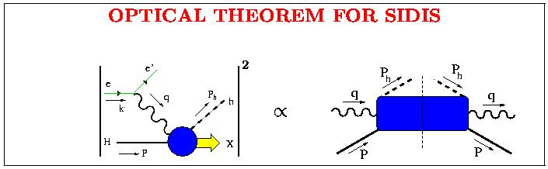
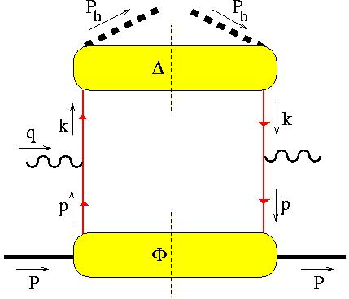
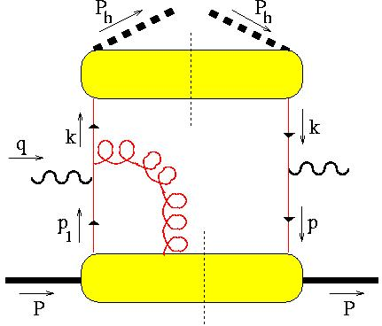
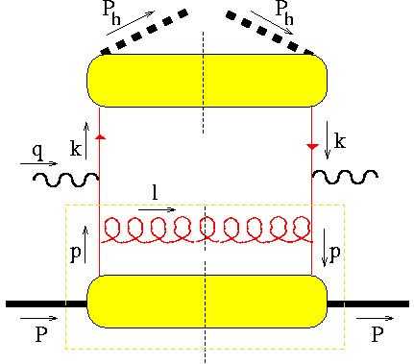
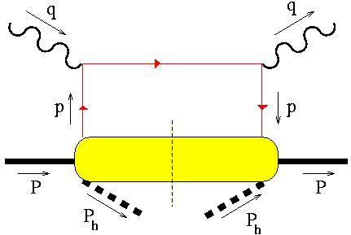
(calculation of) cross section in SIDIS
Full calculation
+
+
LEADING (in 1/Q)
+ …
+

Slide 40
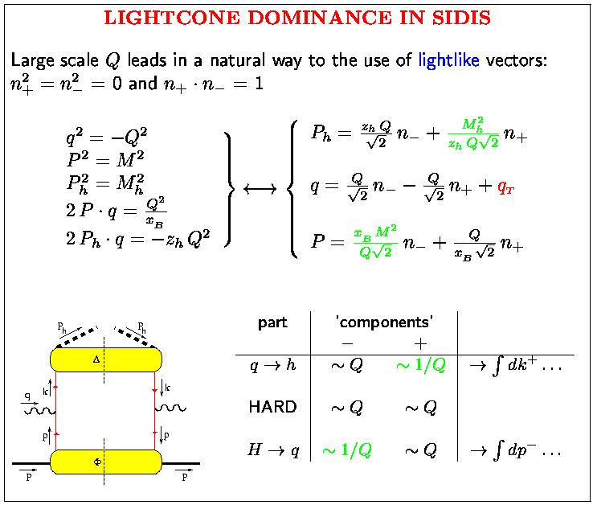
Lightfront dominance in SIDIS
Three external momenta
P P_{h} q
transverse directions relevant
q_{T} = q + x_{B} P – P_{h}/z_{h}
or
q_{T} = -P_{h⊥}/z_{h}

Slide 41
Result for SIDIS
q
P_{h}
k
p
P

Slide 42
relevance and measurability of TMDs

Slide 43
Transverse momentum dependence
Mismatch of hadronic and partonic momenta
Momentum fractions are linked to scaling variables, e.g. SIDIS (up to 1/Q² corrections):
Transverse momenta are convoluted into a measurable off-collinearity,
… or non-alignment of jets in hadron + hadron → jet + jet.

Slide 44
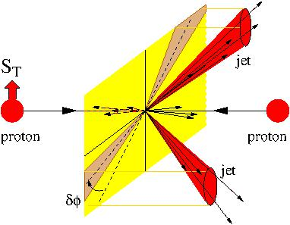
Access to transverse momenta
Also in more complex situations like hadron-hadron collisions
Second scale!
Boer & Vogelsang

Slide 45
Large pT

Slide 46
Large p_{T}
p_{T}-dependence of TMDs
Consistent matching to collinear situation: CSS formalism
Large m² dependence governed by anomalous dim (i.e. splitting functions)
F(x,p_{T})
Fictitious measurement
p_{T}² > μ²
JC Collins, DE Soper and GF Sterman, NP B 250 (1985) 199

Slide 47
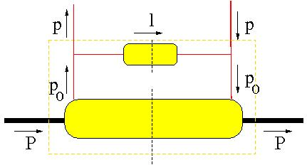
Large values of momenta
Calculable!
hard
p_{0T} ~ M
etc.
M << p_{T} < Q
Bacchetta, Boer, Diehl, M
JHEP 0808:023, 2008 (arXiv:0803.0227)

Slide 48
Complications for TMDs

Slide 49
Hadron correlators
Hadronic correlators establish the diagrammatic link between hadrons and partonic hard scattering amplitude
Quark, quark + gluon, gluon, …
Disentangling a hard process into collinear parts involving hadrons, hard scattering amplitude and soft factors is non-trivial
J.C. Collins, Foundations of Perturbative QCD, Cambridge Univ. Press 2011

Slide 50
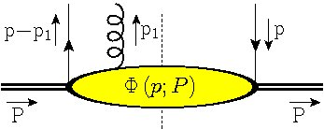
Soft part: hadron correlators
Forward matrix elements of parton fields describe distribution (and fragmentation) parts
Also needed are multi-parton correlators
Φ(p)
Φ_{A}(p-p₁,p)
Notes:
Remark on notation of (p|p)

Slide 51
Color gauge invariance
Gauge invariance in a non-local situation requires a gauge link U(0,ξ)
Introduces path dependence for Φ(x,p_{T})
ξ_{Τ}
ξ
ξ.P
0
Notes:
Matrix elements are not gauge invariant
OPE

Slide 52
Twist analysis (2)
Dimensional analysis to determine importance in an expansion in inverse hard scale
Maximize contractions with n
… or maximize # of P’s in parametrization of Φ
In addition any number of collinear n.A(ξ) = A^{n}(x) fields (dimension zero!), but of course in color gauge invariant combinations
dim 0:
dim 1:

Slide 53
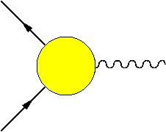
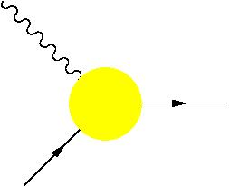
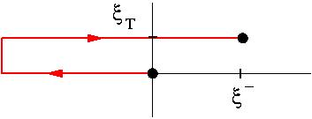
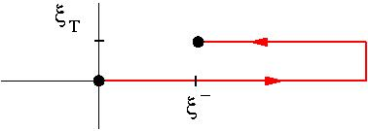
Which gauge links?
TMD
collinear
Gauge links come from dimension zero (not suppressed!) collinear A.n gluons, but leads for TMD correlators to process-dependence:
DY
SIDIS
… A^{n} …
… A^{n} …
Φ^{[-]}
Φ^{[+]}
Time reversal
AV Belitsky, X Ji and F Yuan, NP B 656 (2003) 165
D Boer, PJM and F Pijlman, NP B 667 (2003) 201
Notes:
No unique way
Examples: DY & SIDIS
After integration: the same

Slide 54
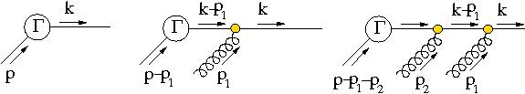
Some details on the gauge links (1)
Proper gluon fields (F rather than A, Wilson lines and boundary terms)
Resummation of soft n.A gluons (coupling to outgoing color-line) for one correlator produces a gauge-line (along n)
Boundary terms give transverse pieces

Slide 55
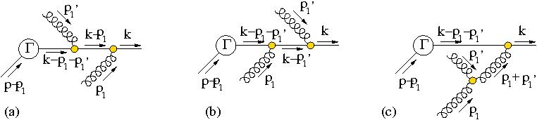
Some details on the gauge links (2)
Resummation of soft n.A gluons (coupling to outgoing color-line) for one correlator produces a gauge-line (along n)
The lowest order contributions for soft gluons from two different correlators coupling to outgoing color-line resums into gauge-knots: shuffle product of all relevant gauge-lines from that (external initial/final state) line.
Contributions of A^{n} gluons can be moved to incoming quark leg (and give gauge links for collinear TMDs). This does not work for A_{T} gluons (no Ward identity and color factors!)

Slide 56
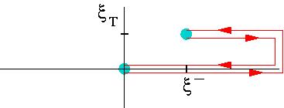



Which gauge links?
The TMD gluon correlators contain two links, which can have different paths. Note that standard field displacement involves C = C’
Basic (simplest) gauge links for gluon TMD correlators:
gg ➔ H
Φ_{g}^{[+,+]}
Φ_{g}^{[-,-]}
Φ_{g}^{[+,-]}
Φ_{g}^{[-,+]}
C Bomhof, PJM, F Pijlman; EPJ C 47 (2006) 147
F Dominguez, B-W Xiao, F Yuan, PRL 106 (2011) 022301
in gg ➔ QQ

Slide 57

Which gauge links?
With more (initial state) hadrons color gets entangled, e.g. in pp
Gauge knot U₊[p₁,p₂,…]
Outgoing color contributes to a future pointing gauge link in Φ(p₂) and future pointing part of a gauge loop in the gauge link for Φ(p₁)
This causes trouble with factorization
T.C. Rogers, PJM, PR D81 (2010) 094006
Notes:
More complicated gauge links
Color-entanglement
Explicit calc: some contributions break factorizatn
On the right, a more detailed picture is visible. No factorization

Slide 58

Which gauge links?
Can be color-detangled if only p_{T} of one correlator is relevant (using polarization, …) but must include Wilson loops in final U
MGA Buffing, PJM, JHEP 07 (2011) 065
Notes:
More complicated gauge links
Color-entanglement
Explicit calc: some contributions break factorizatn
On the right, a more detailed picture is visible. No factorization

Slide 59


Trouble appears already in DY
Complications for DY at measured Q_{T} if the transverse momentum of two initial state hadrons is involved

Slide 60
Summarizing: color gauge invariant correlators
So it looks that at best we have well-defined matrix elements for TMDs but including multiple possiblities for gauge links and each process or even each diagram its own gauge link (depending on flow of color)
Leading quark TMDs
Leading gluon TMDs:

Slide 61



Opportunities to see color-induced phases in QCD
Figures by Kees Huyser

Slide 62
Next step

Slide 63
Basic strategy: operator product expansion
Taylor expansion for functions around zero
Mellin transform for functions on [-1,1] interval
functions in (transverse) plane
Notes:
Mellin moments are being used for decades.
Just a recap.

Slide 64
Operator structure in collinear case (reminder)
Collinear functions and x-moments
Moments correspond to local matrix elements of operators that all have the same twist since dim(D^{n}) = 0
Moments are particularly useful because their anomalous dimensions can be rigorously calculated and these can be Mellin transformed into the splitting functions that govern the QCD evolution.
x = p.n
Notes:
Mellin moments are being used for decades.
Just a recap.

Slide 65
Operator structure in TMD case
For TMD functions one can consider transverse moments
Upon integration, these do involve collinear twist-3 multi-parton correlators
MGA Buffing, A Mukherjee, PJM, PRD 86 (2012) 074030 , Arxiv: 1207.3221 [hep-ph]
Notes:
Gauge link has richer structure
3 matrix elements

Slide 66
Operator structure in TMD case
For first transverse moment one needs quark-gluon correlators
In principle multi-parton, but we need
Φ_{F}(p-p₁,p)
T-even (gauge-invariant derivative)
T-odd (soft-gluon or gluonic pole)
Efremov, Teryaev; Qiu, Sterman; Brodsky, Hwang, Schmidt; Boer, Teryaev, M; Bomhof, Pijlman, M
Notes:
Gauge link has richer structure
3 matrix elements

Slide 67
Operator structure in TMD case
Transverse moments can be expressed in these particular collinear multi-parton twist-3 correlators (which are not suppressed!)
C_{G}^{[U]} calculable
gluonic pole
factors
T-even
T-odd
T-even
T-even
T-odd
Tr_{c}(GG ψψ)
Tr_{c}(GG) Tr_{c}(ψψ)
Notes:
+ or – gauge links this is just +1 or -1
Also be illustrated by looking at the parametrization in PDFs.

Slide 68
Distribution versus fragmentation functions
Operators:
Operators:
out state
T-even
T-odd (gluonic pole)
T-even operator combination, but still T-odd functions!
Collins, Metz; Meissner, Metz; Gamberg, M, Mukherjee, PR D 83 (2011) 071503

Slide 69
Classifying Quark TMDs
Collecting right moments gives expansion into full TMD PDFs of definite rank
but for TMD PFFs

Slide 70
Classifying Quark TMDs
Only a finite number needed: rank up to 2(S_{hadron}+s_{parton})
Rank m shows up as cos(mφ) and sin(mφ) azimuthal asymmetries
No gluonic poles for PFFs
factor | TMD PDF RANK
 | 0 | 1 | 2 | 3
1
factor | TMD PFF RANK
 | 0 | 1 | 2 | 3
1
MGA Buffing, A Mukherjee, PJM, PRD2012 , Arxiv: 1207.3221 [hep-ph]

Slide 71
Classifying Quark TMDs
Only a finite number needed: rank up to 2(S_{hadron}+s_{parton})
Rank m shows up as cos(mφ) and sin(mφ) azimuthal asymmetries
Example: quarks in an unpolarized target are described by just 2 functions
factor | QUARK TMD PDF RANK UNPOLARIZED HADRON
 | 0 | 1 | 2 | 3
1
T-even
T-odd
[B-M function]

Slide 72
Classifying Quark TMDs
factor | QUARK TMD PDFs RANK SPIN ½ HADRON
 | 0 | 1 | 2 | 3
1
Three pretzelocities:

Slide 73
Classifying Quark TMDs
factor | QUARK TMD PDFs RANK SPIN ½ HADRON
 | 0 | 1 | 2 | 3
1
factor | QUARK TMD PFFs RANK SPIN ½ HADRON
 | 0 | 1 | 2 | 3
1
Just a single ‘pretzelocity’ PFF
Process-dependent broadening for h1

Slide 74
Classifying Gluon TMDs
factor | GLUON TMD PDF RANK UNPOLARIZED HADRON
 | 0 | 1 | 2 | 3
1
factor | GLUON TMD PDF RANK SPIN ½ HADRON
 | 0 | 1 | 2 | 3
1

Slide 75
Definite rank functions and Bessel transforms
Terms in p_{T} expansion of TMDs involve
Use azimuthal integration to get actual p_{T}²-dependent TMD PDFs
This is relevant for lattice calculations as well as experimental analysis
In general this produces (m/2) moments of the functions
Boer, Gamberg, Musch, Prokudin, JHEP 1110 (2011), 021; Arxiv: 1107.5294 [hep-ph]

Slide 76
Multiple TMDs in cross sections

Slide 77
Correlators in description of hard process (e.g. DY)
Complications if the transverse momentum of two initial state hadrons is involved, resulting for DY at measured Q_{T} in
Just as for twist-3 squared in collinear DY

Slide 78
Classifying Quark TMDs
factor | TMD RANK
 | 0 | 1 | 2 | 3
1
MGA Buffing, PJM, PRL (2014), Arxiv: 1309.4681 [hep-ph]

Slide 79
Remember classification of Quark TMDs
factor | QUARK TMD RANK UNPOLARIZED HADRON
 | 0 | 1 | 2 | 3
1
Example: quarks in an unpolarized target needs only 2 functions
Resulting in cross section for unpolarized DY at measured Q_{T}
contains f₁
contains h₁^{perp·}
D. Boer, PRD 60 (1999) 014012; MGA Buffing, PRL (2014) PJM, Arxiv: 1309.4681 [hep-ph]

Slide 80
Conclusion with (potential) rewards
(Generalized) universality studied via operator product expansion, extending the well-known collinear distributions (including polarization 3 for quarks and 2 for gluons) to novel TMD PDF and PFF functions, ordered into functions of definite rank.
Knowledge of operator structure is important for lattice calculations.
The rank m is linked to specific cos(mφ) and sin(mφ) azimuthal asymmetries.
TMDs encode aspects of hadronic structure, e.g. spin-orbit correlations, such as T-odd transversely polarized quarks or T-even longitudinally polarized gluons in an unpolarized hadron, thus possible applications for precision probing at the LHC, but for sure at a polarized EIC.
The TMD PDFs appear in cross sections with specific calculable factors that deviate from (or extend on) the naïve parton universality for hadron-hadron scattering.

